Slide 1
Advanced Sentiment Analysis and Semantic Retrieval System
Ananda Rabidas Mughdo 20233120010

Slide 2
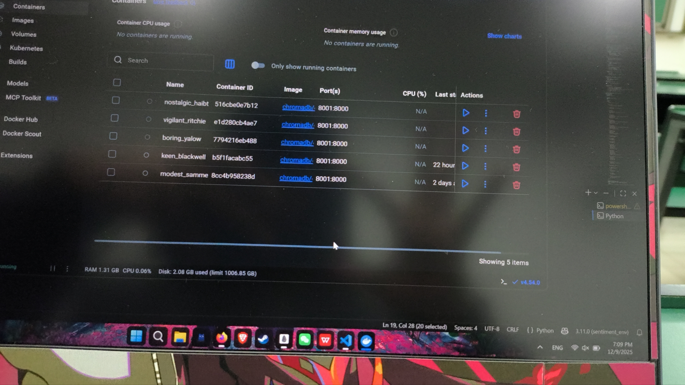
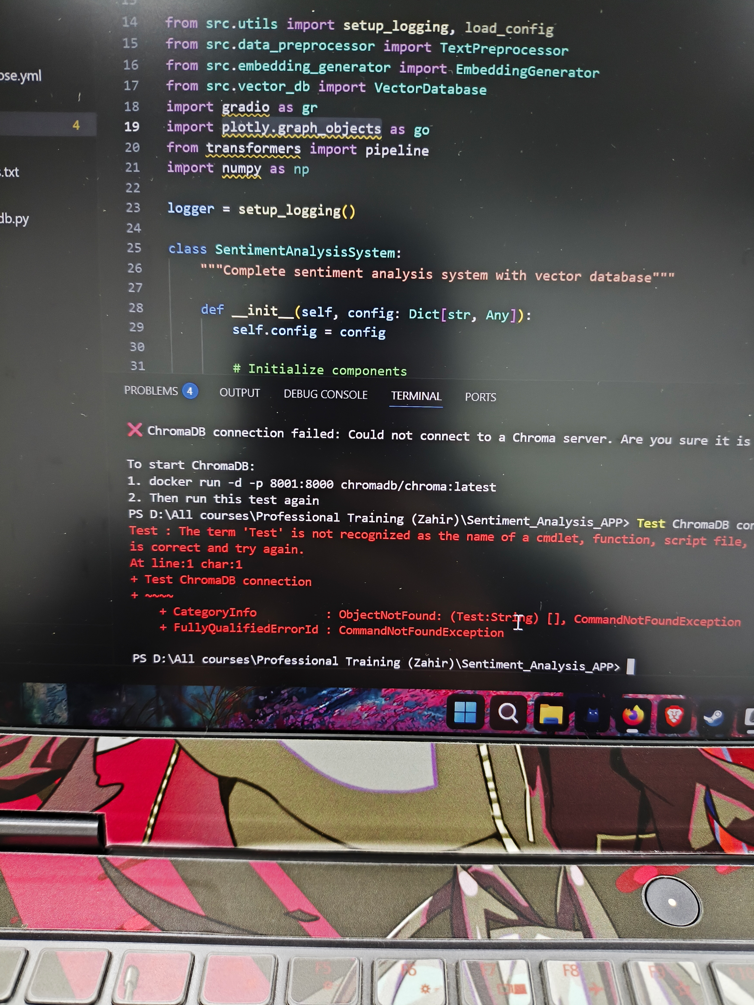
Problems
Even though this part says this is the issue. After my prologned suffering i notificed it had to do with several library version compatability
Several times i built the project but the containers never responded, sometimes after I was done building the container didn’t even show at the docker container

Slide 3
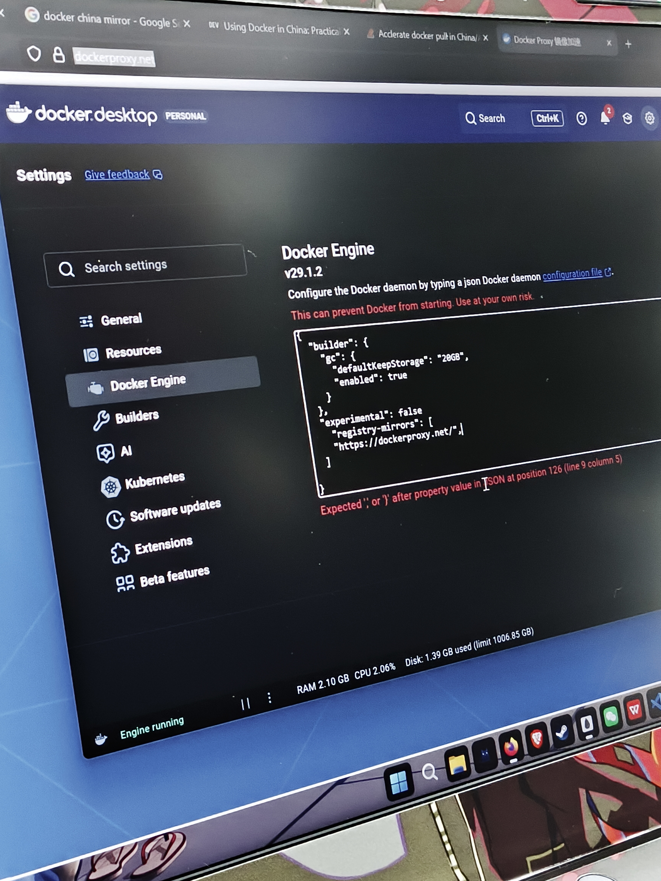
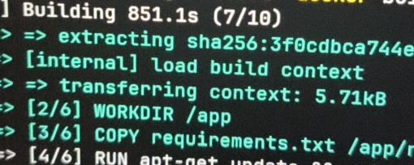
In before I started the project I didn’t do this part so while I was building it stopped several times.
Sometimes it even got stuck at certain number not responding

Slide 4
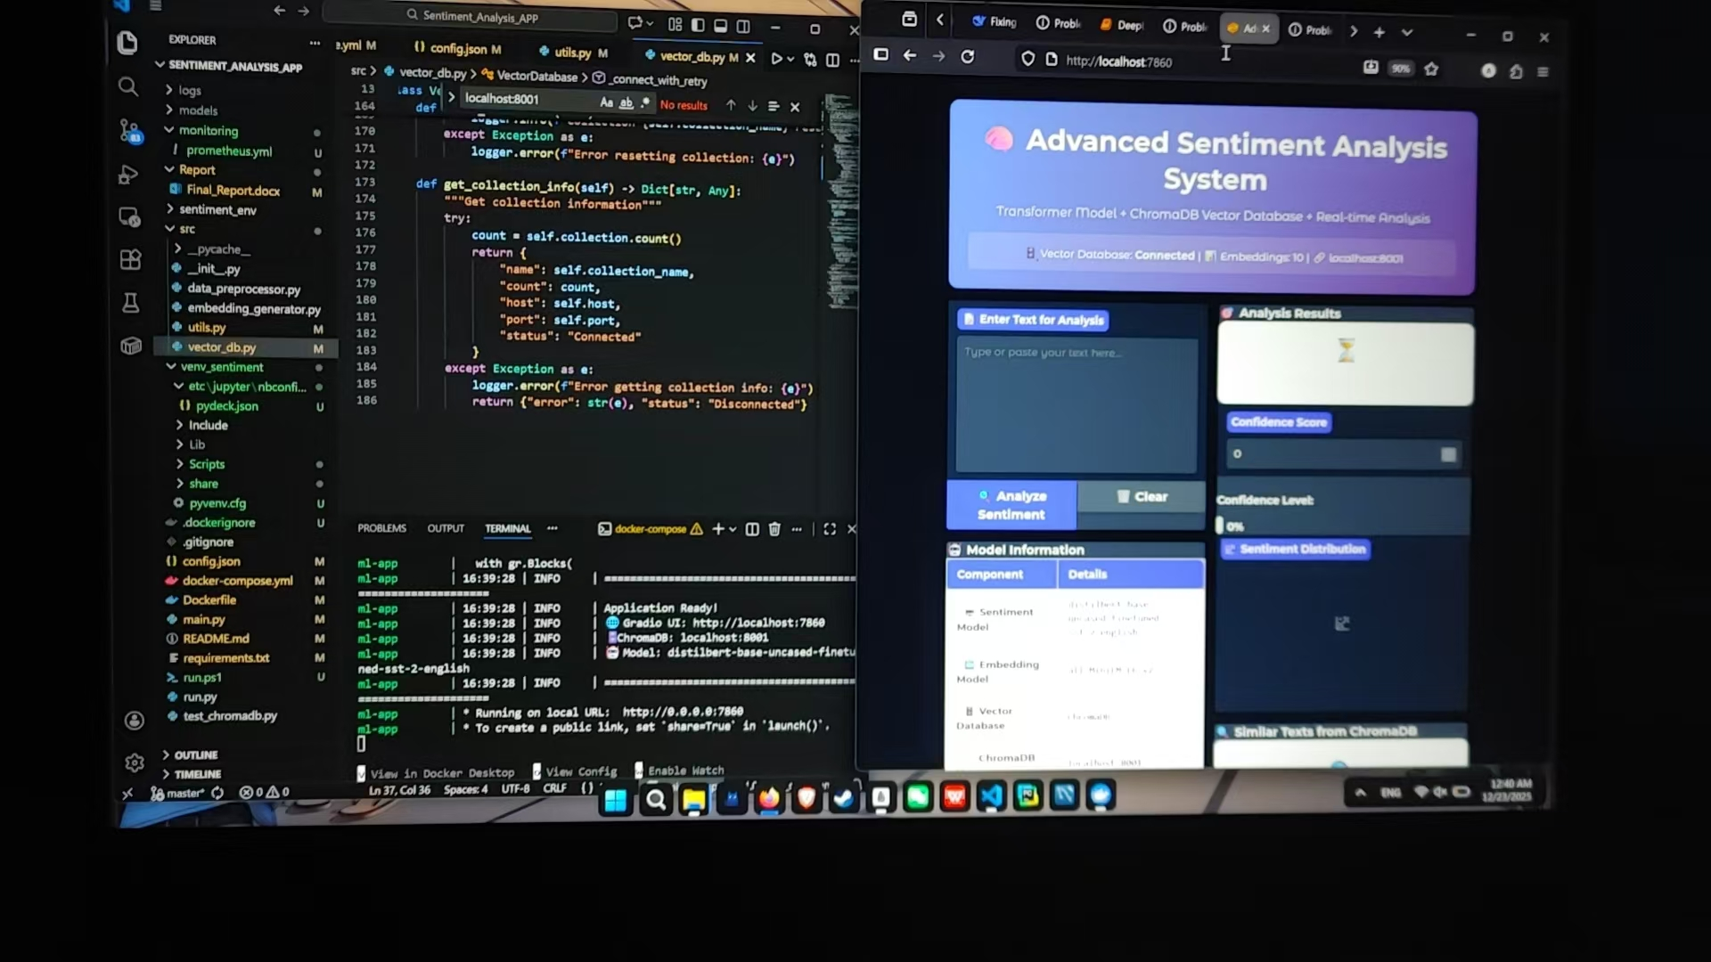

Slide 5
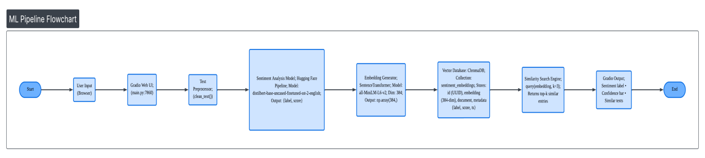
System Architecture Overview
A linear workflow processing data from user input to final retrieval.
Dual-Path Inference: Simultaneous sentiment classification and vectorization.
Feedback Loop: Real-time visualization through Gradio UI.

Slide 6
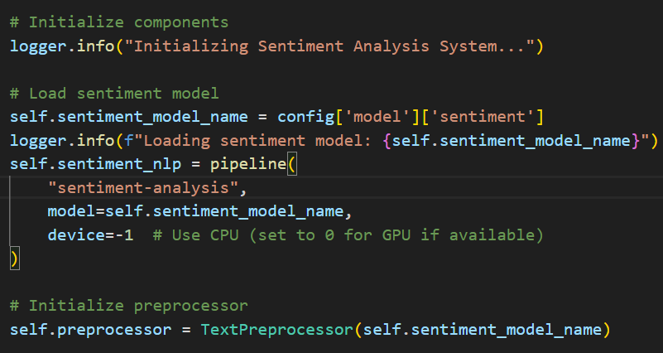
Machine Learning Models
Classification: distilbert-base-uncased-finetuned-sst-2-english.
Chosen for 91.3% accuracy and high computational efficiency.
Embedding: all-MiniLM-L6-v2.
Generates 384-dimensional dense vectors where spatial distance equals meaning.

Slide 7
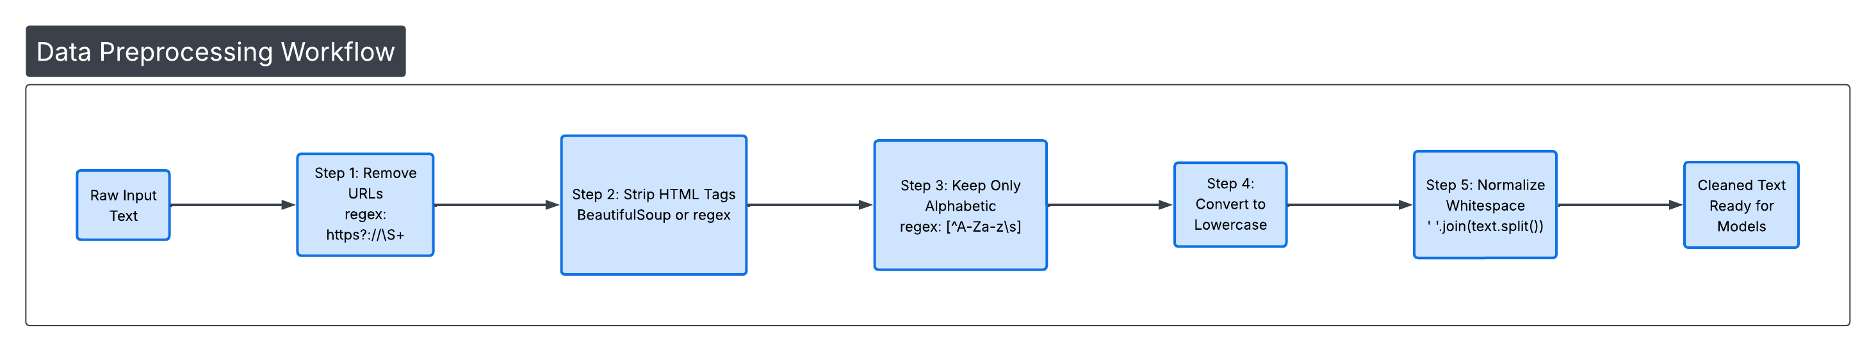
Data Preprocessing Workflow
5-Stage Pipeline: URL/HTML removal, character standardization, case normalization, and whitespace cleanup.
Context Preservation: Intentionally avoids stopword removal and stemming to help Transformers retain full contextual meaning.

Slide 8
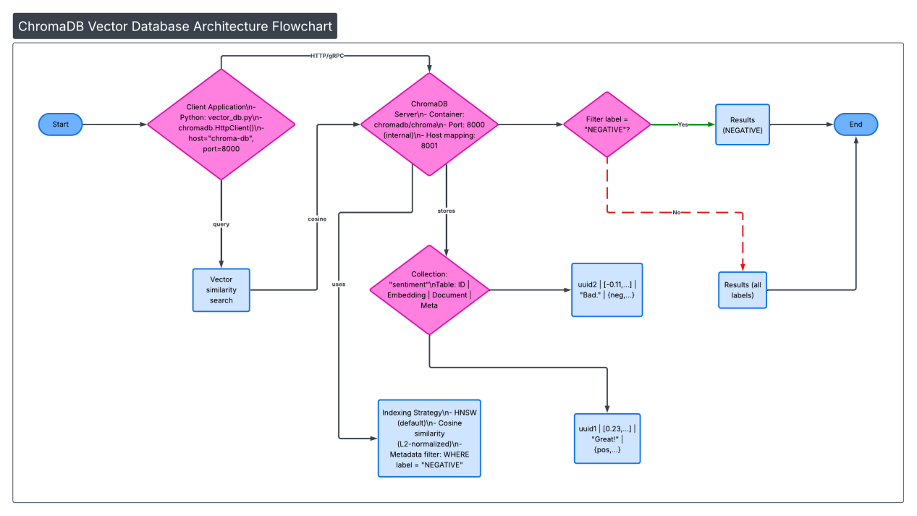
Vector Database (Semantic Memory)
HNSW Indexing: High-speed approximate nearest neighbor search for results in milliseconds.
Persistent Storage: Data survives system restarts through Docker volumes.
Hybrid Search: Combines semantic similarity with metadata filtering ( "Find similar NEGATIVE reviews").

Slide 9
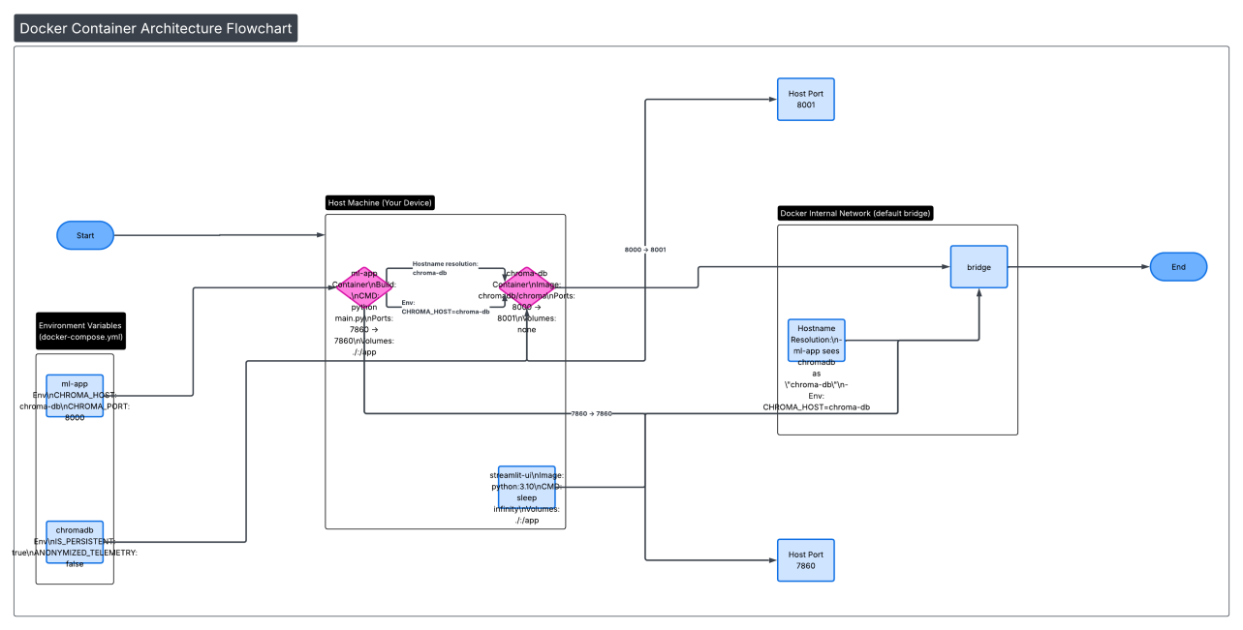
Docker Deployment Strategy
Service Isolation: Decoupled ml-app and chroma-db services.
Inter-container DNS: Communication via a Bridge Network using service names instead of IPs.
Reliability: Implemented _connect_with_retry logic to handle asynchronous service booting.

Slide 10
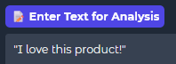
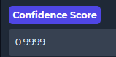
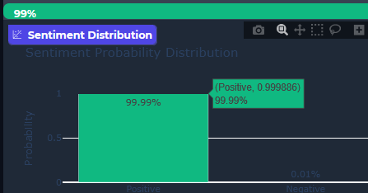
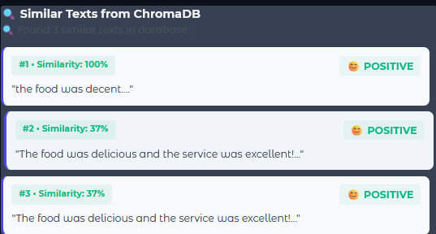
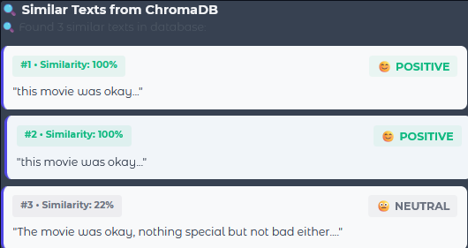
Live Demo - System in Action
Positive Case: "I love this product!" → 99.99% confidence.
Querying "This movie was okay" retrieves conceptual matches like "The food was decent".

Slide 11
Thank you

